Slide 1

AI based diabetes prediction system
Problem definition and design thinking
9.24.XX

Slide 2

Agenda
INTRODUCTION
The problem is to build an AI-powered diabetes prediction system that uses machine learning algorithms to analyze medical data and predict the likelihood of an individual developing diabetes. The system aims to provide early risk assessment and personalized preventive measures, allowing individuals to take proactive actions to manage their health.

Slide 3

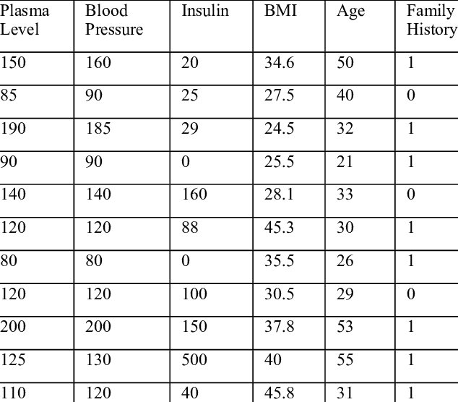
.
Data collection

Slide 4

Data Cleaning: Handling Missing Values: Identify and deal with missing data. You can either remove rows with missing values, impute missing values using statistical techniques, or use domain knowledge to fill in missing information. Outlier Detection and Handling: Identify and handle outliers that may be errors or unusual cases. You can choose to remove, transform, or impute outliers based on the specific context Data Normalization: (optional): Normalize the data distribution if necessary, for example, by using techniques like log transformation or Box-Cox transformation to make it more Gaussian-like.
Data preprocessing

Slide 5

Feature selection is an essential step in the process of building predictive models, such as predicting diabetes risk. It involves choosing a subset of the most relevant features (also known as variables or attributes) from your dataset while discarding irrelevant or redundant ones. Proper feature selection can help improve model performance, reduce overfitting, and simplify the model Data Exploration: Begin by understanding your dataset. Look at the distribution of features, their relationships with the target variable (diabetes risk), and whether there are any missing values or outliers. Feature Importance: Calculate or estimate the importance of each feature in predicting diabetes risk. Common techniques for this include: Using statistical tests like correlation coefficients or chi-squared tests for categorical variables. Applying tree-based algorithms (e.g., Random Forest, XGBoost) and examining feature importance scores. Univariate feature selection methods that evaluate the relationship between each feature and the target variable independently Iterative Process: Feature selection is often an iterative process. You may need to experiment with different feature subsets and fine-tune your selection based on model performance. Monitor Model Performance: Keep track of how your model's performance (e.g., accuracy, AUC, F1-score) changes as you modify the feature set. Ensure that removing or adding features improves the model's predictive power. .
Feature selection :

Slide 6
Model selection is a crucial step in the machine learning pipeline. It involves choosing the most appropriate algorithm or ensemble of algorithms for your specific prediction task, such as predicting diabetes risk. Experimenting with different machine learning algorithms is a good approach to find the one that performs best. Here's how you can approach model selection Data Splitting: Split your dataset into training, validation, and test sets. The training set is used to train the models, the validation set is used to tune hyperparameters and select the best-performing model, and the test set is reserved for final evaluation. Baseline Model: Start with a simple baseline model to establish a performance benchmark. For binary classification tasks like predicting diabetes risk, a baseline model might be predicting the majority class for all instances (e.g., predicting "no diabetes" for all patients). This helps you assess whether more complex models provide meaningful improvements. Selection of Algorithms: Logistic Regression: is a good starting point for binary classification problems. It's simple, interpretable, and can serve as a baseline model. Random Forest: Random Forest is an ensemble learning method that can handle both numerical and categorical data. It's known for its robustness and ability to capture complex relationships in data. Gradient Boosting: Gradient Boosting algorithms like XGBoost, LightGBM, or CatBoost often perform well in predictive tasks. They can capture intricate patterns in the data and are highly customizable.
model selection :

Slide 7
Accuracy: Accuracy measures the proportion of correctly predicted instances (both true positives and true negatives) out of all instances. It's a commonly used metric but can be misleading in imbalanced datasets where one class is much more prevalent than the other. In such cases, high accuracy can be achieved by simply predicting the majority class. Precision: Precision measures the proportion of true positive predictions out of all positive predictions made by the model. It focuses on the correctness of positive predictions. High precision indicates that the model has a low rate of false positives. Recall (Sensitivity): Recall measures the proportion of true positive predictions out of all actual positive instances in the dataset. It focuses on the model's ability to identify all positive cases. High recall indicates that the model has a low rate of false negatives. F1-Score: The F1-Score is the harmonic mean of precision and recall. It balances precision and recall and provides a single metric that considers both false positives and false negatives. It is useful when you want to find a balance between precision and recall. ROC-AUC (Receiver Operating Characteristic - Area Under the Curve): ROC-AUC is a metric for binary classification that measures the area under the Receiver Operating Characteristic curve. It assesses the model's ability to distinguish between the two classes across different probability thresholds. A higher ROC-AUC indicates better discrimination between classes
evalution :

Slide 8

Iterative improvement is a common approach in machine learning and data science. By fine-tuning model parameters and exploring techniques like feature engineering, you can gradually enhance prediction accuracy. This process involves iteratively making adjustments, testing the model, and refining it until the desired level of performance is achieved. If you have any specific questions or need guidance on a particular aspect of iterative improvement
Iterative Improvement :

Slide 9
Thank YOU

